Slide 1
Texas Forensic Science Academy
Property & Evidence Management Certificate Program
to
Texas Criminal Justice Integrity Unit
October 5, 2012

Slide 2
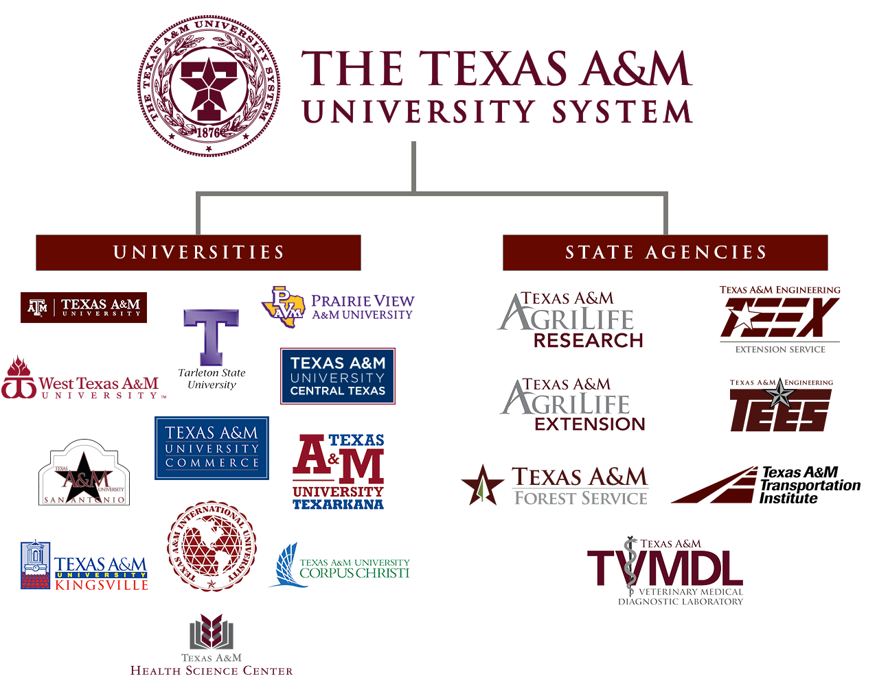
2

Slide 3
Program History
March 2006: TEEX uses local funding to develop the Texas Forensic Science Academy program for law enforcement officers and crime scene investigators
3

Slide 4
TEEX/TAPEIT Partnership
January 2009: TEEX receives invitation from TCJIU to brief Texas Forensic Science Academy
During meeting TCJIU recommends TEEX collaborate with Texas Assoc. of Property & Evidence Inventory Technicians
TEEX/TAPEIT determine potential for online training for property and evidence technicians
4

Slide 5
Basic Property Technician
September 2010: TEEX & TAPEIT sign MOU for online Basic Property Technician course
June 2011: TEEX launches online Basic Property Technician course; TAPEIT supports development
TAPEIT recognizes course for certification
Almost 200 students thru August 2012
5

Slide 6
Property & Evidence Management Certificate
March 2012: TEEX establishes the Property & Evidence Management Certificate
Three courses:
Basic Property Technician (on-line)
Forensic Photography 1
Courtroom Testimony
6

Slide 7
Texas Forensic Science Academy
Property & Evidence Management Certificate Program
to
Texas Criminal Justice Integrity Unit
October 5, 2012

