Slide 1
HGN and dwi investigations
Lieutenant Jimmy Jackson
Texas Department of Public Safety

Slide 2
DWI Investigations
NHTSA Validation Studies 1977
Standardized Field Sobriety Testing prior to 1995
NHTSA Re-Validation Studies 1995-1998
1995 – Colorado
1997 – Florida
1998 – San Diego (.08)
TECLEOSE requirement in 2005
Current
Texas Department of Public Safety

Slide 3
Divided Attention Concepts
-Common opinions of Field Sobriety Tests.
-Divided Attention and its relationship with driving
-Divided Attention and Field Sobriety testing.
Texas Department of Public Safety

Slide 4
Divided Attention Tests
Walk and Turn –
  Instruction Stage
    2 validated Clues
  Walking Stage
    6 Validated Clues

Slide 5
Walk & Turn Test Clues
1. Can’t balance during instructions
2. Starts too soon
3. Stops while walking
4. Doesn’t touch heel to toe
5. Steps off the line
6. Uses arms for balance
7. Improper turn (or loses balance on turn)
8. Wrong number of steps
Texas Department of Public Safety
VIII - 21

Slide 6
Divided Attention Tests
One Leg Stand –
  Instruction Stage
  Balance and Counting Stage
    Four Validated Clues

Slide 7
One Leg Stand Test Clues
1. Sways while balancing
2. Uses arms to balance
3. Hops
4. Puts foot down

Slide 8
Divided Attention and Field Sobriety Tests
a. Walk-and-Turn is a field sobriety test based on the important concept of divided attention.
b. The test requires the suspect to divide attention among mental tasks and physical tasks.
c. The mental tasks include comprehension of verbal instructions; processing of information; and, recall of memory.
d. The physical tasks include balance and coordination; the suspect is required to maintain balance and coordination while standing still, walking, and turning.
Texas Department of Public Safety

Slide 9
Horizontal Gaze Nystagmus
HGN is a 10 step process.
1. Remove Eyeglasses
2. Verbal Instructions
3. Check for Equal Pupil Size
4. Check for Resting Nystagmus (Officer Safety)
5. Check for Equal Tracking
(Validated Clues)
6. Lack of Smooth Pursuit
7. Distinct and Sustained Nystagmus at Maximum Deviation
8. Onset of Nystagmus Prior to 45 Degrees
9. Total the clues
10. Vertical Nystagmus
Texas Department of Public Safety

Slide 10
Three Clues of Horizontal Gaze Nystagmus
1. Lack of Smooth Pursuit
Move the stimulus to the person’s left, your right
It should take approximately 2 seconds to bring it to the side
Check the other eye at the same speed
Repeat
Two Seconds
Nose Left Side
Texas Department of Public Safety

Slide 11
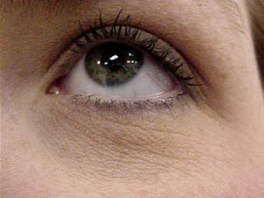
No Lack of Smooth Pursuit
Texas Department of Public Safety

Slide 12
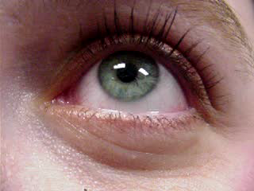
Lack of Smooth Pursuit
Texas Department of Public Safety

Slide 13
Three Clues of Horizontal Gaze Nystagmus
Cont'd
2. Distinct & Sustained Nystagmus at Maximum Deviation
Move the stimulus to the person’s left
Hold the stimulus at the corner of the eye (no white showing) for at least 4 seconds
Check the other eye and hold for same length. Repeat
At least 4 seconds
Nose Left Side
Texas Department of Public Safety
Supplemental

Slide 14
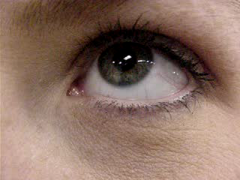
No Distinct and Sustained at Maximum Deviation
Texas Department of Public Safety

Slide 15
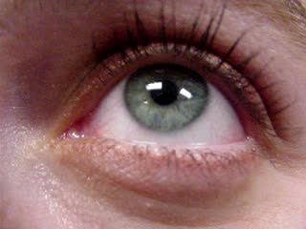
Distinct and Sustained at Maximum Deviation
Texas Department of Public Safety

Slide 16
Three Clues of Horizontal Gaze Nystagmus
Cont'd
3. Onset of Nystagmus Prior to 45 Degrees
Slowly (at least 4 seconds) move the stimulus to the person’s left
At least 4 seconds
If nystagmus is observed, hold the stimulus to verify it continues
Check the other eye and hold for same length
Repeat
45 Degrees
Texas Department of Public Safety
Supplemental

Slide 17
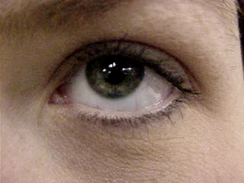
No Onset of Nystagmus prior to 45 Degrees
Texas Department of Public Safety

Slide 18
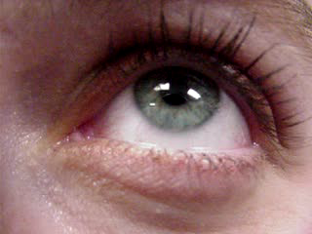
Onset of Nystagmus Prior to 45 Degrees
Texas Department of Public Safety

Slide 19
Vertical Gaze Nystagmus
Move the stimulus vertically
At least 4 seconds
Raise the stimulus until the individual’s eyes are elevated as far as possible and hold for at least four seconds
Repeat
An indicator of a high dose of alcohol for that particular individual.
Texas Department of Public Safety
Supplemental

Slide 20
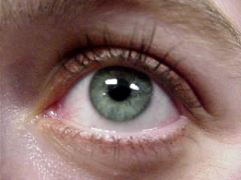
Vertical Nystagmus
Texas Department of Public Safety

Slide 21
Simplicity
Is it reasonable to assume that, if sober…
Anyone like the suspect
You
The Judge
The Suspect
The Jurors
…Would “pass” the test?
Texas Department of Public Safety
VII - 5

Slide 22
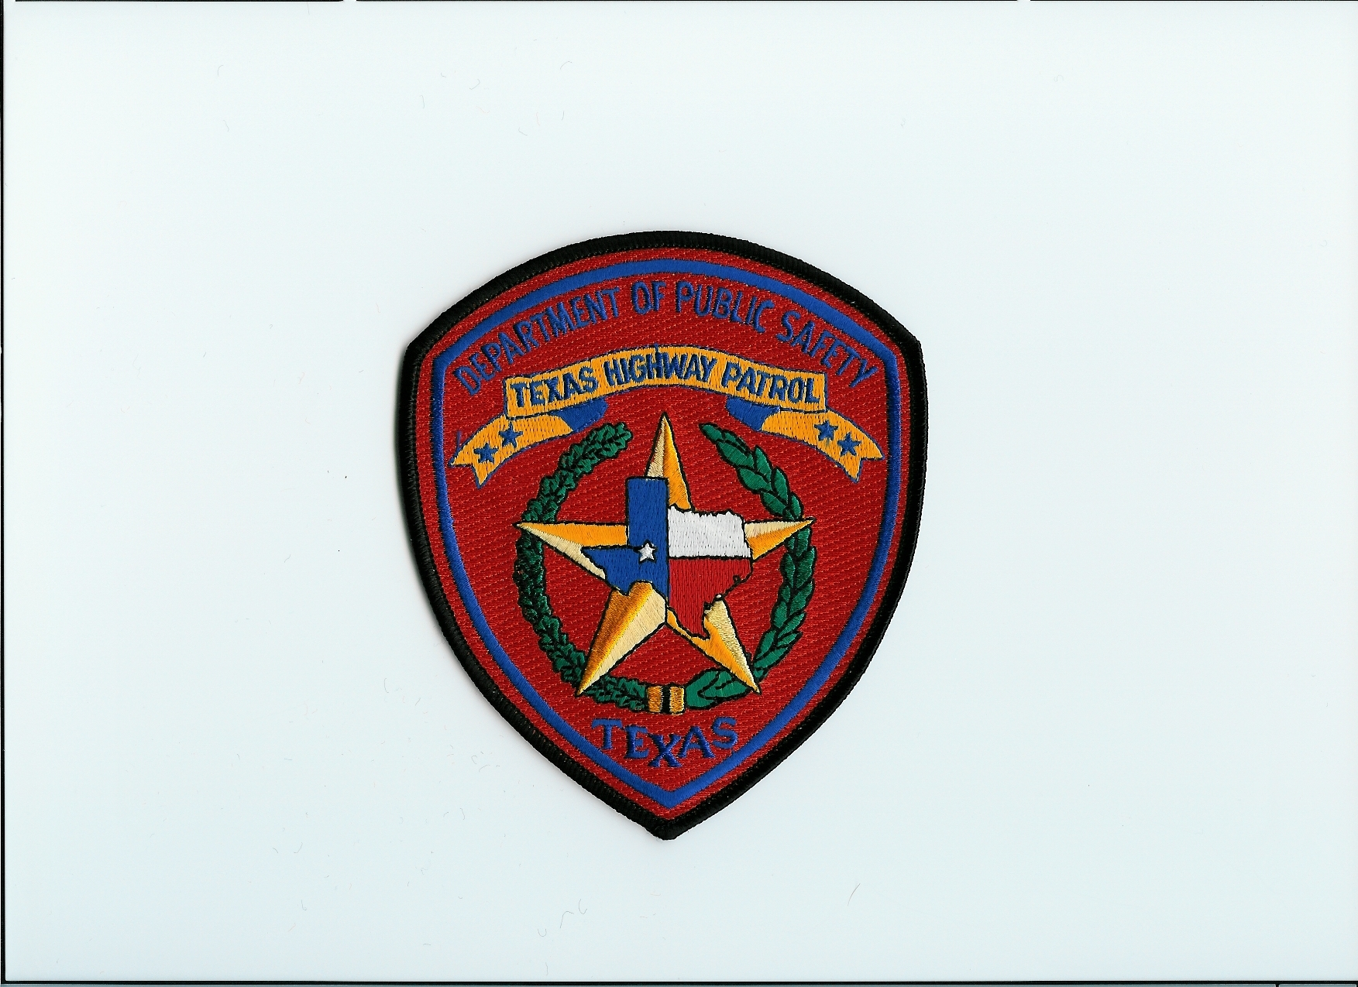
James.R.Jackson@txdps.state.tx.us

